Slide 1



CAPSTONE PROJECT
CURBIO INC. RESEARCH ON NEW MARKET OPPORTUNITIES
UNDER THE GUIDANCE OF DR.CHONGQI WU

Slide 2
Group Members
Devi Nadimpally
Karan Malik
Manogna Reddy
Richa Arora

Slide 3




Agenda
Data Scraping
Data Preprocessing
Data Visualization and Analysis
Regression Model

Slide 4


Objective
All homes need updates and repairs before going on the market, but the traditional improvement process is slow, unreliable, and can be risky when a home transaction is on the line
The Goal of this project is to help Curbio to build its business models. It focuses on helping Curbio in data driven market research through analysis and modelling and helping the company in taking key decisions about the outlook/growth opportunities for the coming years.

Slide 5
Curbio Inc?
It is a leading start-up in the home renovation space that provides pre-approved home renovation options to home sellers, based on datasets acquired from Zillow.
The pre-approved options help Curbio to bring in a new source of revenue by adding a tiered based business model.
6-8% share on increased price after the home sells + cost of renovation” (gold Tier).
Renovate and sell the property for the client includes brokerage (Platinum Tier).

Slide 6

How Curbio Works?

Slide 7
Process Flow
Scrapping
Data Visualization
Insights
Research questions
Cleaning
Data Preparation
Linear Modelling
Notes:
Manogna

Slide 8

Web Scrapping

Slide 9

Web Scrapping Process
Identifying the target website
Collected the URL’s of each city property listings in Zillow, for this project, collected both listings and sold property URL’s
Requesting URL’s to get the HTML page: made a request using request object, using beautiful soup package to capture the JSON present in the “hdpApolloPreloadData”
Finding the data in html & extracting the data: We parsed the Jason using Jason package, the Jason is a nested Json (JSON inside a JSON), so we used a nested to record library to de-normalize the chaining in the JSON, that is flattening it into multiple data columns. We extracted the data to an excel and combined both the listing and sold properties excel data files and then loaded it into a data frame for data pre-processing and further analyses.

Slide 10
DATA PREPROCESSING

Slide 11
1. Dropping unwanted columns and Data Deduplication
Motive: To avoid inaccurate predictions or inferences.
Dropped the Zillow derived and repeating columns from the 779 columns and shortlisted 253 columns for further analyses.
Also made sure that, there are no duplicate rows in the data-frame.
2. Feature Selection
Motive: To avoid feeding the model with noise or unnecessary data.
Used Pearson correlation coefficient technique and further reduced the columns to 51 from 253.
3. Missing Value imputation (zero, knn, mode)
It is quite common to see null values, also called as missing values in the data frame.
Motive: To retain the data/information from the data set.
KNN Imputer : used for imputing categorical data.
Mode Imputation: used for imputing numerical data.
Nulls in Fireplace are replaced by 0.
Nulls in Zestimate are replaced by Price values.
Notes:
duplicate data may be responsible for negative targeting implications, poor branding, unnecessary data storage, marketing budget waste and maybe a reason for many other effects, so it is best to check for duplicate values and remove them if there are any.

Slide 12
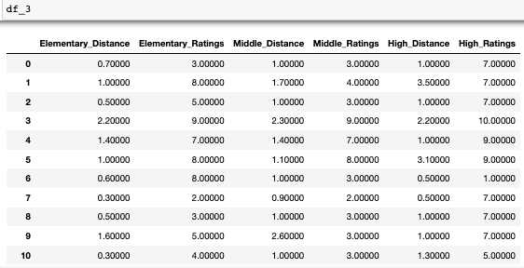
4. Feature Engineering
Motive: To improve the model performance.
The school cell is as below
[{'distance': 0.7, 'name': 'Parker Elementary', 'rating': 3, 'level': 'Elementary', 'studentsPerTeacher': 20, 'assigned': None, 'grades': 'K-8', 'link': 'https://www.greatschools.org/school?id=00249&state=CA', 'type': 'Public', 'size': 314, 'totalCount': 1, 'isAssigned': True}]
Derived 6 attributes from school and replaced it with these 6 columns
Notes:
The process of creating a new feature from or using the existing features is called feature engineering.

Slide 13
5. Detecting Outliers
Motive: To produce a better-fitted model or statistically significant results.
simply removing outliers may not be the best practice to produce a better-fitted model or statistically significant results. What if the outlier value is a natural part of the dataset we are studying?
6. Removing Multicollinearity
Multicollinearity occurs when independent variables in a regression model are highly correlated to each other.
Motive: To decrease the standard errors of the coefficients.
VIF (Variance Inflation Factor): We are dropping all the columns whose VIF value is greater than 12.5

Slide 14

DATA VISUALIZATION

Slide 15
Libraries, Packages & Plots
Packages Fetched:
Plotly
pip install plotly
Libraries Imported:
matplotlib.pyplot
seaborn
plotly.express
plotly.graph_objs
make_subplots
Functions Implemented:
matplotlib.axes.Axes.scatter()
matplotlib.axes.Axes.plot()
matplotlib.axes.Axes.hist()
seaborn.scatterplot()
seaborn.heatmap()

Slide 16
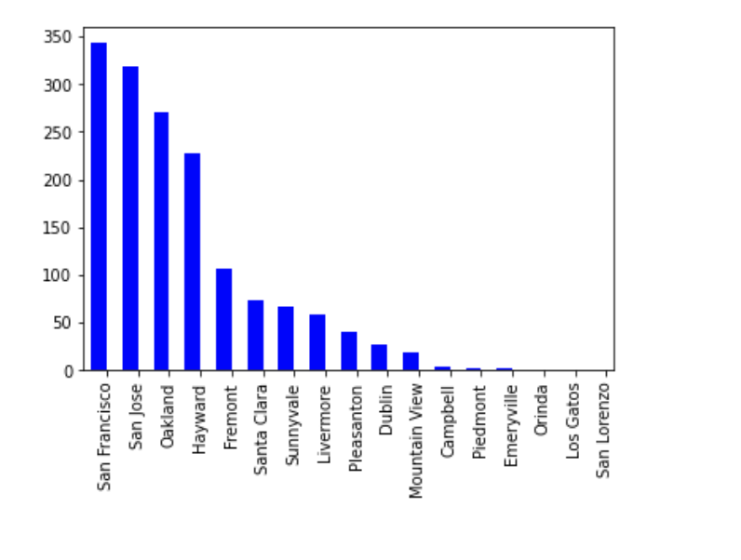
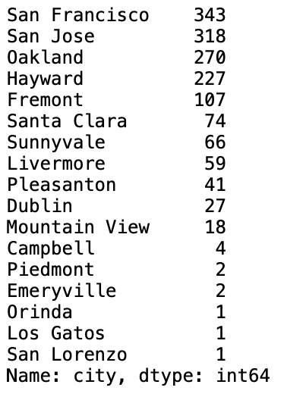
TOTAL NUMBER OF LISTINGS IN EACH CITY
Objective:
To determine the number of residences for sale in bay area.
Work:
Created a series from the column 'city' and bar is plotted showing the count of available homes in each city of the bay area.
Inference:
San Francisco city has the number of homes available for sale.
San Lorenzo, Orinda, Los Gatos has one home in the market for sale.

Slide 17
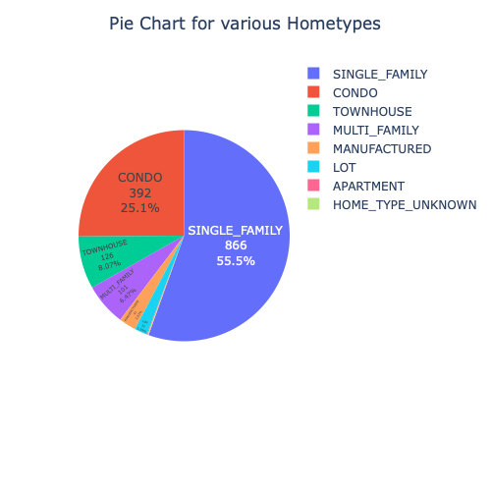
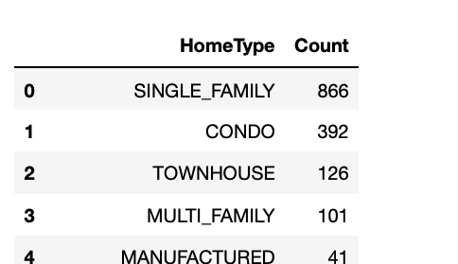
Most popular Home type
Objective:
To Identify the most popular home type.
Work:
Installed plotly.express
Calculated the frequency of each style of home.
Developed a pie chart to show the different home types and their popularity.
Inference:
Single family houses are the most popular home type with 55.5% availability.
Condo homes are the second most popular home type which is of 25.1%
Townhouse,Multi family and Manufactured have less than 10% contribution each
Lots are the less available home types which is about 1.99%.

Slide 18
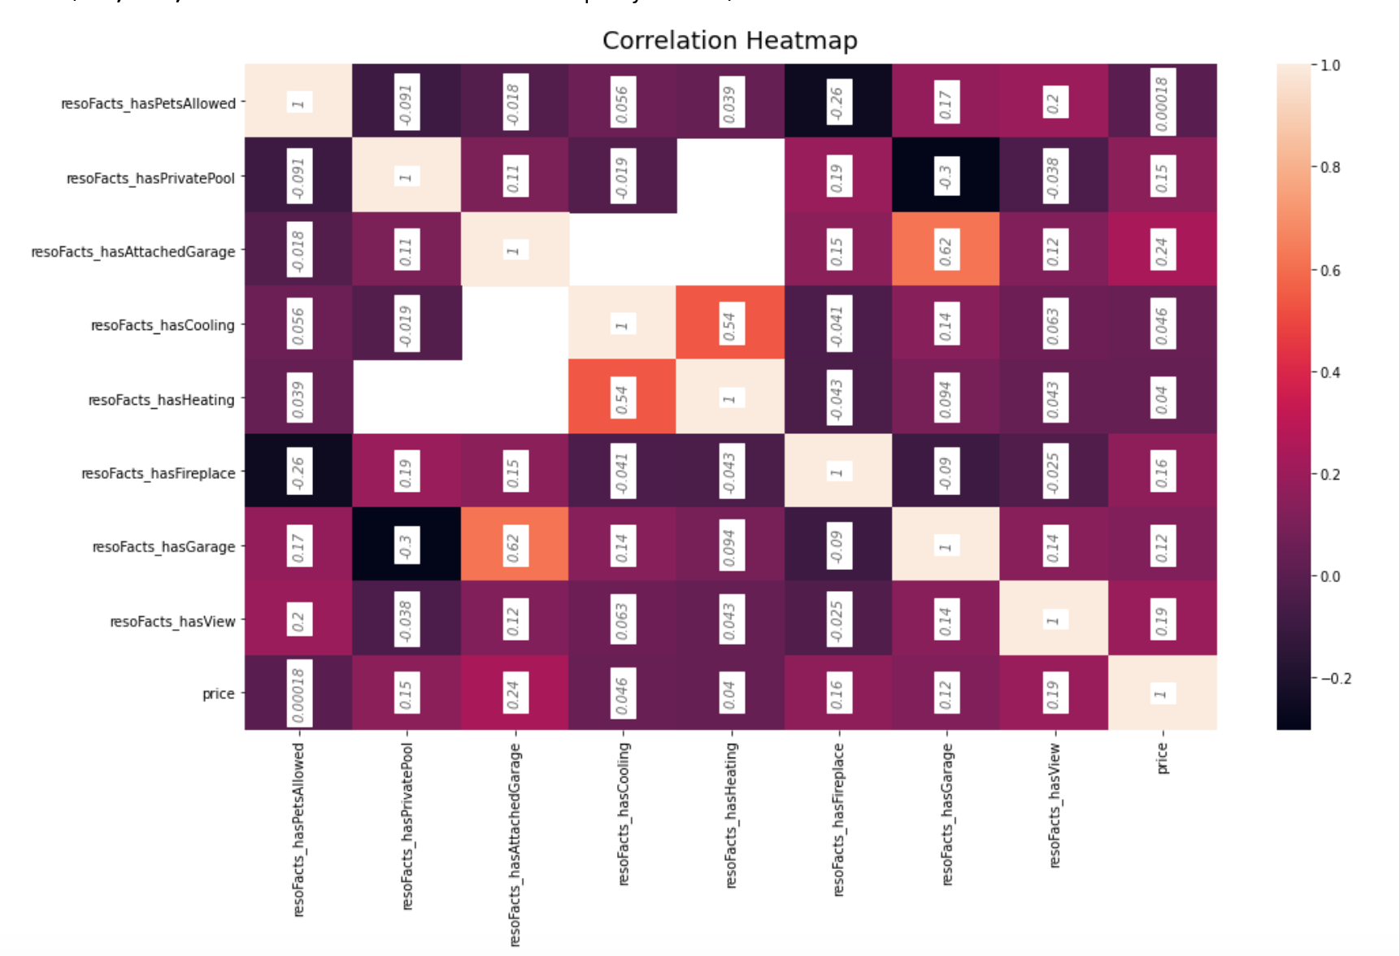
Impact of having extra features like a fireplace, pool,view etc on price.
Objective:
To know the correlation of
parameters with respect to price.
Work:
Created a dataframe with required parameters to derive correlation
Inference:
Attached Garage, View, Fireplace, Private Pool has very high impact on price.
In contrast Garage, Cooling and Heating finally Pets Allowed has less impact on variation on price.

Slide 19
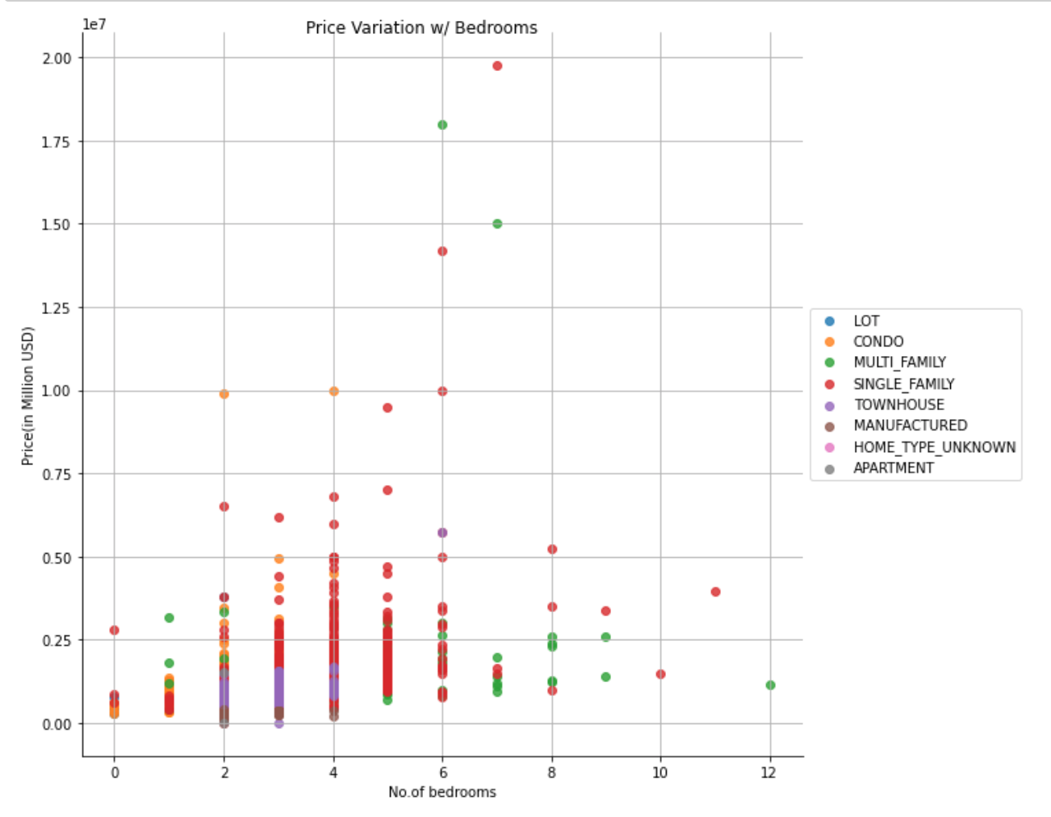
Variation of Property with Bedrooms
Objective:
To analyze the Variation of Property Price with Bedrooms.
Work:
A scatter plot was mapped with parameters : Property Price, No. of Bedrooms, with Home Type taken as the marker.
Inference:
Scatter plot of Property price and No.of bedrooms, with Home type as the marker.
With the increase in number of bedrooms from 0 to 7 , there is increase in the price for single family and condo home types.
Lot, TownHouse, Manufactured, Apartment has slight increase in the price with respect to no.of bedrooms.
we can infer that Price has the positive linear relationship with number of bedrooms.

Slide 20
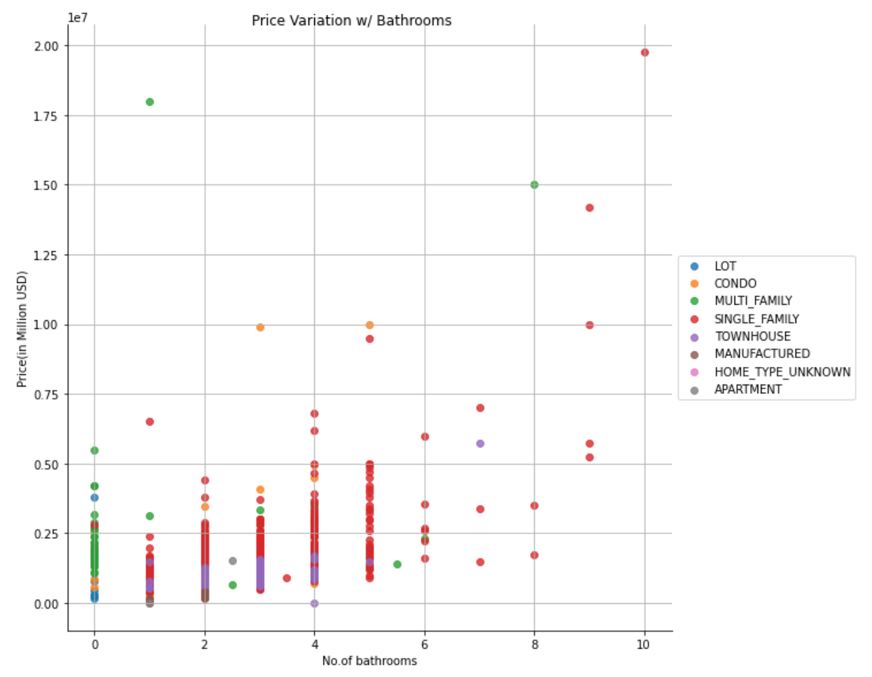
Variation of Property with Bathrooms
Objective:
To analyze the Variation of Property Price with Bathrooms.
Work:
A scatter plot was mapped with parameters : Property Price, No. of Bathrooms, with Home Type taken as the marker.
Inference:
Price is increasing with the increase in number of bathrooms for a single-family homes.
The maximum price of Condo homes available in bay area with less than 5 bathrooms is within 1 million.

Slide 21
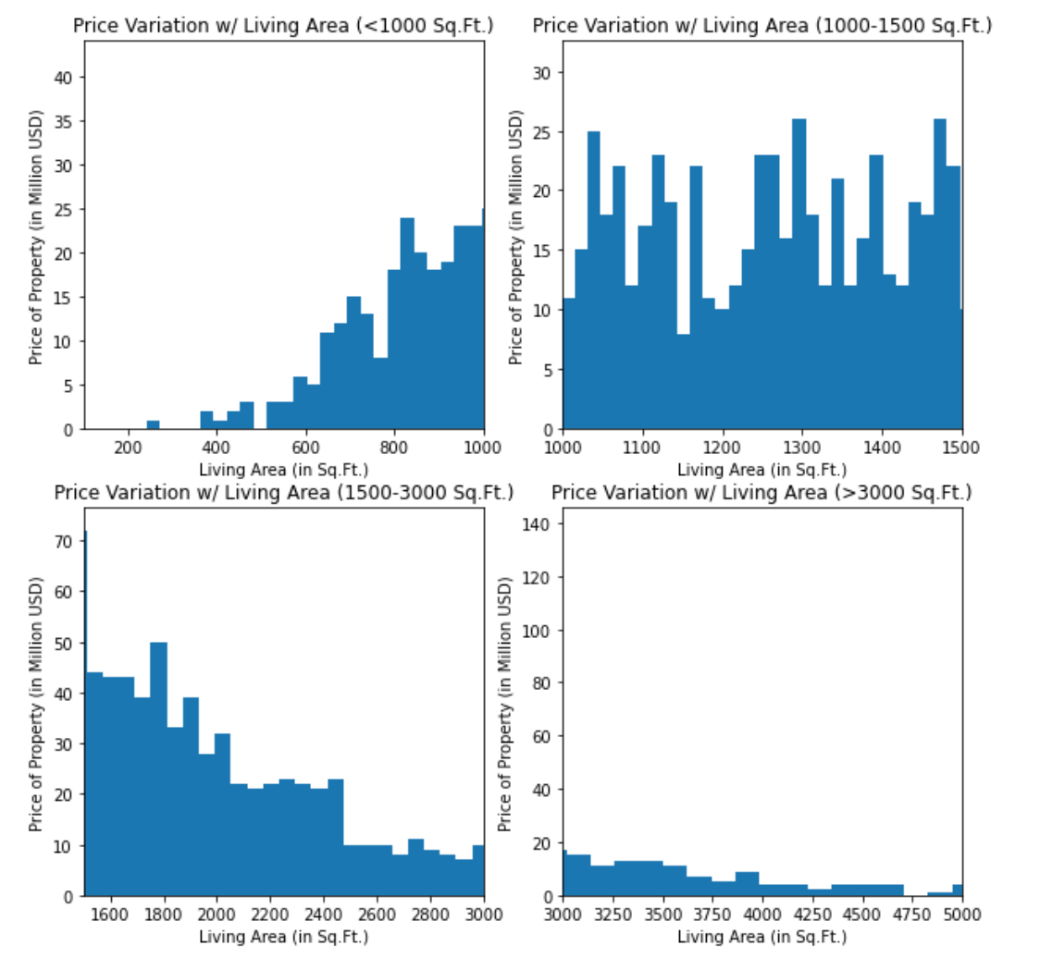
Variation of Property Price with Living Area
Objective:
To analyze the Variation of Property Price with Living Area.
Work:
A histogram was plotted with parameters : Property Price, Living Area; with Living Area partitioned into 4 categories, for a better understanding of the spread.
Inference:
As observed, when living area is between 600sq.ft to 1500sq.ft there is increase in the price.
while price starts decreasing rapidly when living area is between 2400- 5000sq.ft

Slide 22
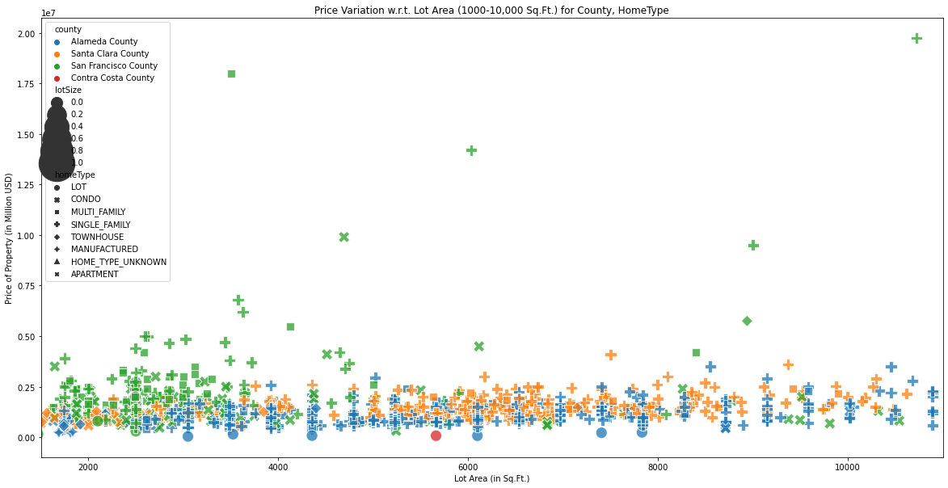
Variation of Property Price with Lot area
Objective:
To analyze the Variation of Property Price with Lot Area.
Work:
A scatter plot was mapped with parameters : Property Price, Lot Area, with County, Home Type taken as the marker.
Inference:
In San Francisco county the homes are mostly between 2,000sq.ft to 5,000sq.ft
The price in San Francisco county is under 1 million and very few homes are over a million.
Santa Clara county and Alameda has homes with area ranging from 2,000 to 10,000sq.ft. while the property price is below 500k dollars.

Slide 23
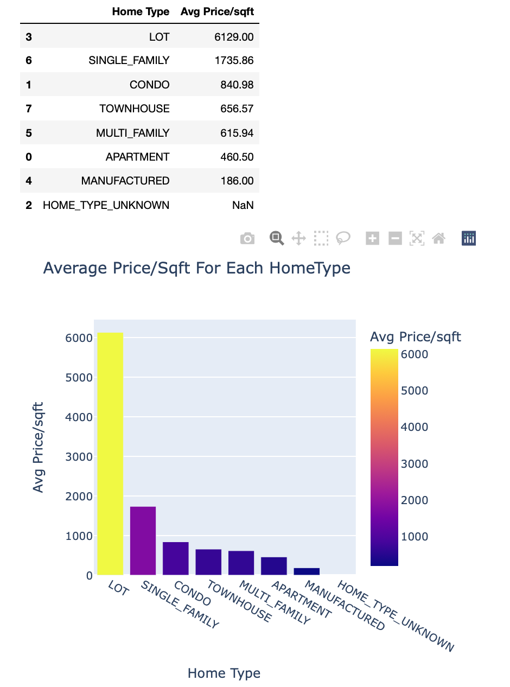
Most expensive and cheapest home types
Objective:
To find the most expensive and the cheapest type of homes
Work:
● Home type and price Per Square Foot details were used;
Grouped them by home type.
● Calculate average price/sqft for each home type
Inference:
Lot has the highest average price i.e., $6129/sq.ft.
Single family which is most popular home type and has approximately $1736/sq.ft.
The average price for condo and Townhouse is $840/sq.ft and $815/sq.ft respectively.
Apartment has average price of $460/sq.ft .
Manufactured home type has the least average price of $186/sq.ft.

Slide 24

Average housing price for 3 bedrooms and 2 bathrooms
The number of houses that have 3 bedrooms and 2 bathrooms are 294
The average price of a house that have 3 bedrooms and 2 bathrooms in the bay area is $1,176,288
Average housing price for 5 bedrooms and 3 bathrooms in the bay area
The number of houses that have 5 bedrooms and 3 bathrooms are 32
The average price of a house that have 4 bedrooms and 3 bathrooms in the bay area is $ 1,635,996
Average housing price for 4 bedrooms and 3 bathrooms in the bay area
The number of houses that have 4 bedrooms and 3 bathrooms are 134
The average price of a house that have 4 bedrooms and 3 bathrooms in the bay area is $ 1,536,853

Slide 25
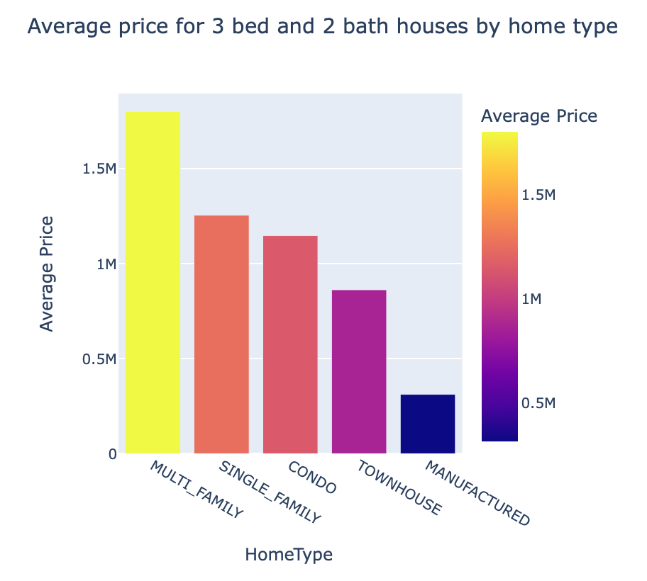
Average housing price for 3 bedrooms and 2 bathrooms for different home types
​​​​
Objective:
To find avg price of a 3 bed 2 bath home by home types
work:
For all the bedrooms with 3 bed and 2bath were used group with home type and average housing price is calculated
Analysis:
The average house price for 3 bedroom and 2 bath is high for multi family home types with approximately 1.8 Million dollars
Single family and Condo home types with 3bed and 2bath has 107k dollar difference. i.e, single family average price is about 1.25 million dollars while condo is 1.15 million dollars.
Average price of Townhouse is 862k dollars, Manufactured are the cheapest home types which is less than 400k dollars.

Slide 26
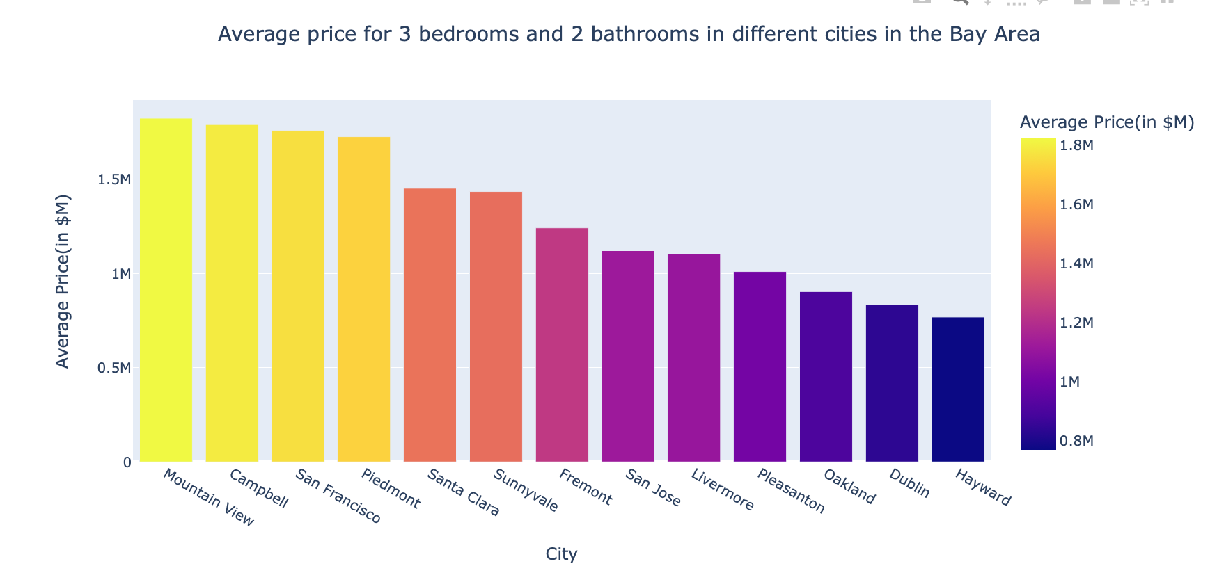
Average housing price for 3 bedrooms and 2 bathrooms in the bay area by cities?
Objective:
To find avg price of a 3 bed 2 bath home by cities.
work:
For all the bedrooms with 3 bed and 2bath were used group with city and average housing price is calculated
Analysis:
Mountain View is the most expensive area, followed by Campbell and San Francisco in terms of 3 bedrooms and 2 bath homes
one can buy a home in campbell, San Francisco and Piedmont with budget of 1.7 million to 1.8 millions.
Pleasanton, Oakland, Dublin and Hayward stands as the cheapest areas compared to other cities to buy a home within 1 million.

Slide 27
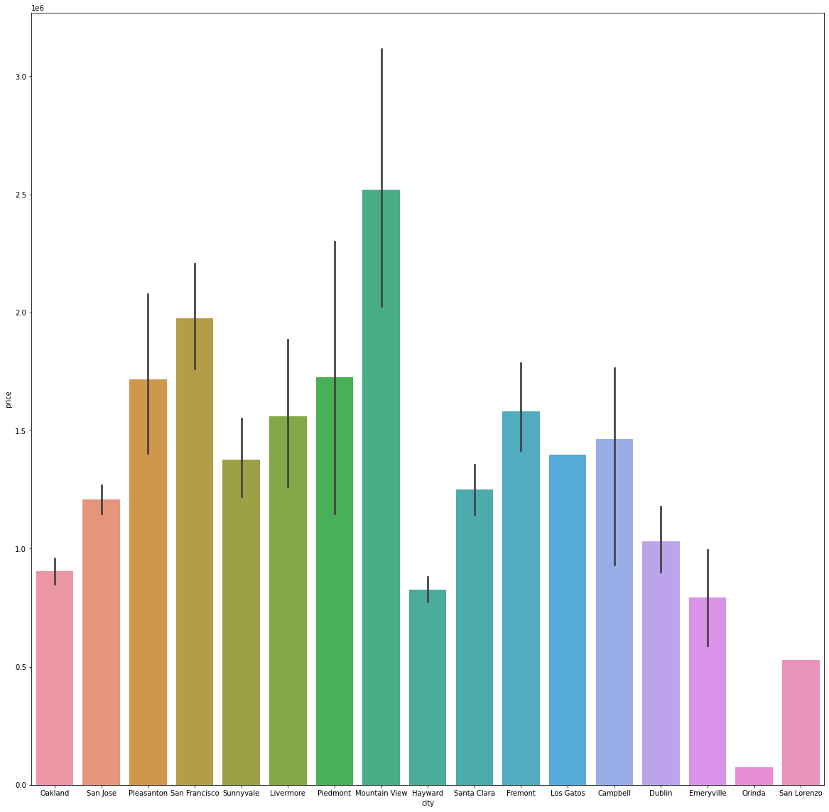
Variation of Property Price with Location
Objective:
To check property price with location
Work:
A bar plot was mapped with parameters : City and Price
Analysis:
The price is less though the Orinda city has the best school ratings.
Mountain view has the highest price followed by San Francisco.
Piedmont and Pleasanton have almost same price.

Slide 28
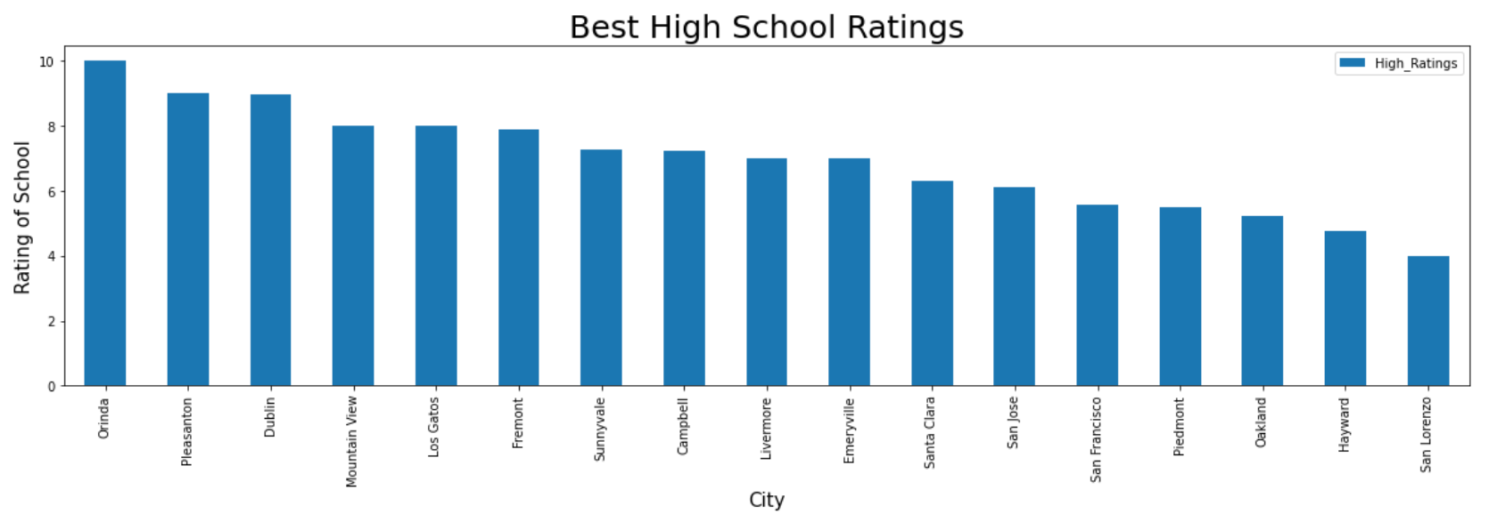
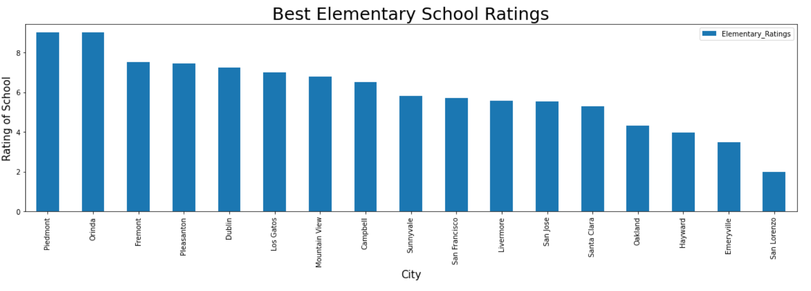
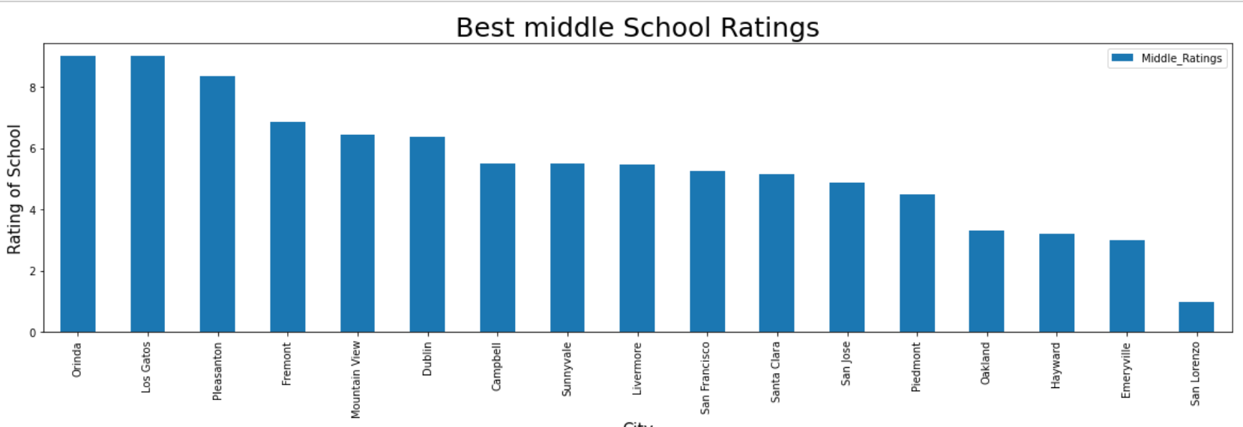
City with highest Elementary, Middle and High school ratings
Objective:
To find which city have the best school ratings.
Work:
Bar plot is mapped with the required attributes: Elementary school ratings, Middle school ratings, High school ratings, city.
Analysis:
Piedmont has the highest elementary school rating, while middle and high school ratings are not great
Orinda has the best elementary, middle and high school ratings.
San Lorenzo school ratings are very low compared to other cities.
Pleasanton, Dublin, Fremont, Mountain View, Los Gatos are the safest places to buy home considering the school ratings.

Slide 29
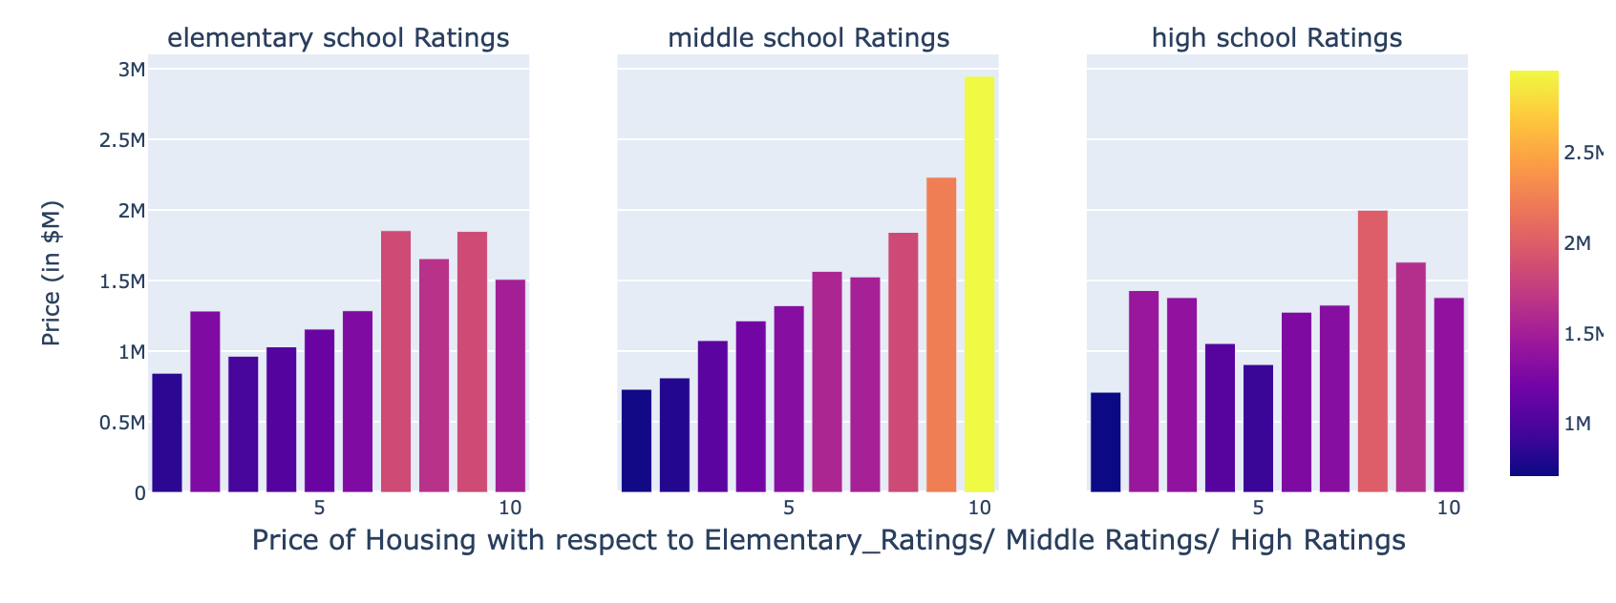
Impact of School ratings on housing prices in Bay Area
Objective:
To check the impact on price with respect to school ratings
Work:
Created a data frame with attributes city, price, elementary rating, middle ratings and high school ratings.
The data is plotted using subplots having same x-axis help us to understand the impact on price with respect to the school rating
Analysis:
we can observe that there is linear positive relation between school ratings and price.
The home price are high in the cities with elementary school ratings above 5.
The middle schools with 10 rating has the expensive homes.
The price is more where the high school ratings are 8 compared to the school which has 9 and 10.
This could be because of data points

Slide 30
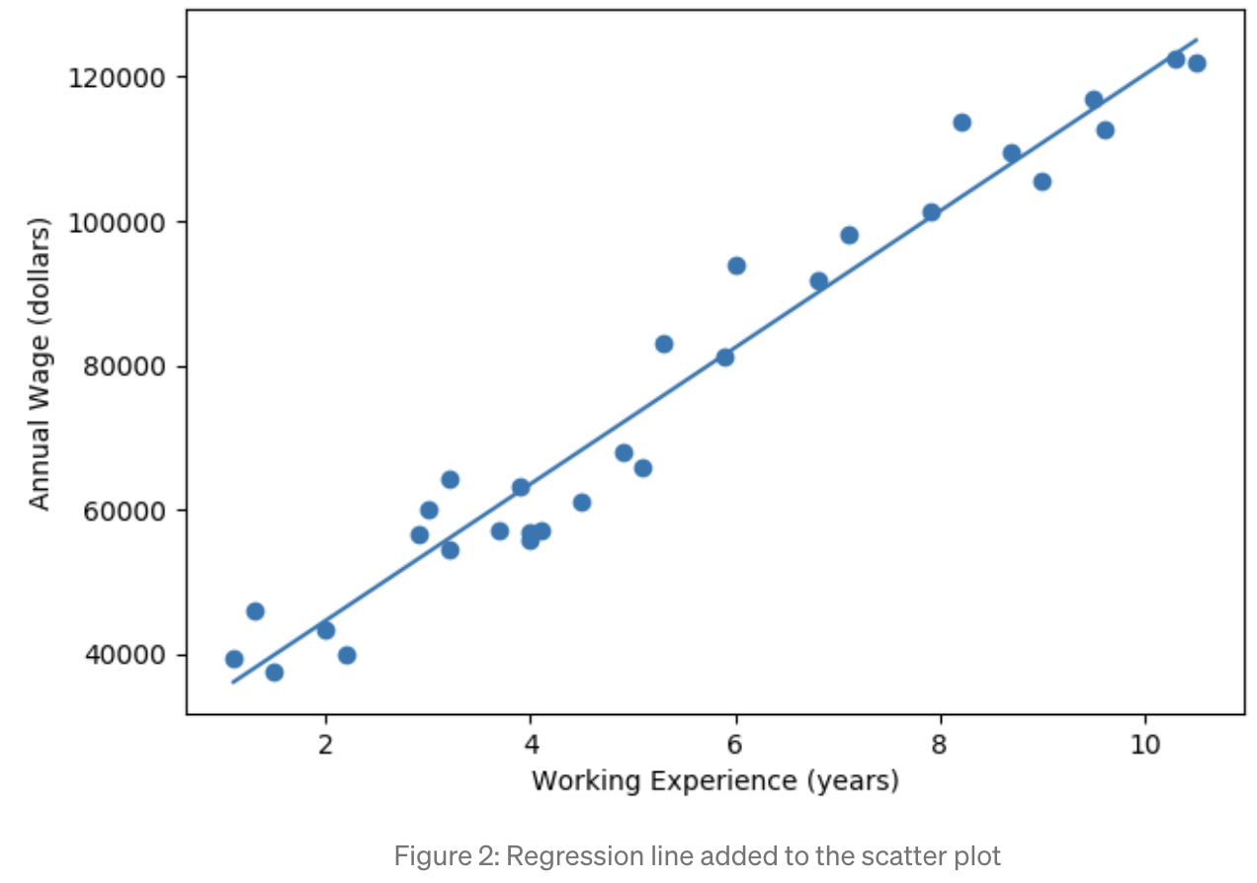
REGRESSION The process of finding a straight line that best approximates a set of points on a graph. Y = b0 + b1X Y = b0 + b1x1 + b2x2 + … + bk-1xk-1 + bkxk
LINEAR REGRESSION:
Linear regression attempts to model the relationship between two variables by fitting a linear equation to observed data. One variable is considered to be an explanatory variable, and the other is considered to be a dependent variable.
OLS REGRESSION:
Ordinary Least Squares regression (OLS) is a method for estimating the coefficients of linear regression equations that describe the relationship between one or more independent quantitative variables and a dependent variable (simple or multiple linear regression).
Ordinary Least Squares regression (OLS), helps to obtain reliable estimators of the coefficients so that we are able to investigate the relationships among the variables of interest.

Slide 31






1. Train-Test Split
Motive: To evaluate the model’s performance, we need to use observations that aren't used in the training process.
Splitting the data into train and test set, making sure that the model is trained only on the training data, and tested on the test data.
2. One-hot encoding & numeric data scaling
Motive: To improve prediction accuracy of the models.
Using one-hot encoder on categorical variables to convert them into numerical data.
scaling the numerical data makes it easy for a model to learn and understand the problem.

Slide 32
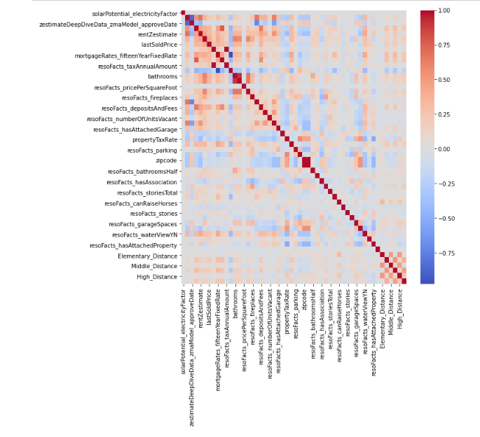
Correlation heat map

Slide 33
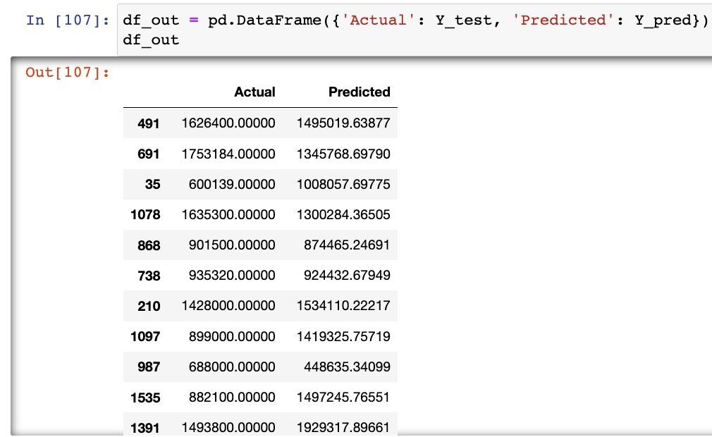
MODEL PERFORMANCES
How To Interpret R-squared in Regression Analysis ?
R-squared is a goodness-of-fit measure for regression models.
Linear Regression:
R-squared value= 0.901
Adjusted R-square value= 0.895
OLS Regression:
R-squared value= 0.845
Adjusted R-square value= 0.838

Slide 34

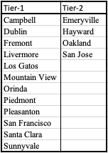
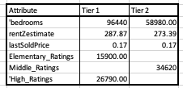
Tier-1 and Tier-2 Classification
How?
Why?
Based on the percentage of crime and the median value of owner-occupied housing units from the FBI crime reports excel found in the google.
Tier 1 cities are more bang for the buck for the company. On average, if we compare the two sister cities of San Jose and Santa Clara, on average tier 1 city had an increase of 97k in property value compared to 56k in tier 2 cities.
The cost of materials and labor is constant across the cities in the bay area the company gains more profit on the properties in tier 1 compared to tier 2.
Gold Tier:
“6-8% share on increased price after the home sells + cost of renovation”
We can limit the risk by introducing plan A (gold tier) to only Tier 1 cities.
Platinum Tier: (Gold tier brokerage)
“Renovate and sell the property for the client includes brokerage”
Since the profit is not much in Tier 2 cities compared to Tier 1 in similar renovation conditions, we should bundle brokerage services to maximize profit.
So, for tier 2 cities curbio inc should promote/limit its product to only the Platinum tier to gauge similar profits from the same cities.

Slide 35


